Slide 1
Chapter 19: Software Quality Assurance

Slide 2
Key Takeaway Points
Software quality assurance encompasses a set of activities to ensure that the software under development or modification will meet functional and quality requirements.
Software quality assurance activities are life-cycle activities.
19-<number>

Slide 3
SQA in the Methodology Context
Business goals
& needs
Current situation
Use case-iteration allocation matrix
Accommodating
Requirements Change
Customer
feedback
Acquiring
Requirements
(Domain Modeling)
Iteration use cases
Domain Modeling
Preliminary requirements
Domain model
Domain model
Deriving Use Cases
from Requirements
Actor-System Interaction Modeling
Abstract & high level use cases, use case diagrams
Expanded use cases & UI design
Allocating Use Cases & Subsystems
to Iterations
Behavior Modeling &
Responsibility Assignment
Behavior models
Use case-iteration allocation matrix
Deriving Design Class
Diagram
Producing an Architecture Design
Design class diagram
Software architecture
Test Driven Development, Integration, & Deployment
(a) Planning Phase
(b) Iterative Phase – activities during each iteration
control flow
data flow
control flow & data flow
19-<number>

Slide 4
What is Software Quality Assurance?
SQA is a set of activities to ensure that the software product and/or process confirms to established requirements and standards.
The activities include
  Verification: Are we building the product right?
  Validation: Are we building the right product?
  Technical reviews
  Testing: Attempts to uncover program errors.
19-<number>

Slide 5
Cost of Quality
Cost of quality consists of
  Costs of preventing software failures
    Costs to implement an SQA framework (one time)
    Costs to perform SQA activities (on going)
    Costs to monitor and improve the framework (on going)
    Costs of needed equipment (machines and tools)
  Costs of failure
    Costs to analyze and remove failures
    Costs of lost productivity (developer and customer)
    Costs of liability, lawsuit, and increased insurance premium
    Costs associated with damage to company’s reputation
19-<number>

Slide 6
Cost of Quality
Cost
Prevention Cost
Higher
Failure Cost
Higher
Quality
Software engineering considers costs to accomplish something. Quality and cost trade-off.
19-<number>

Slide 7
Costs of Quality
1000
relative error correction cost
field operation
100
system test
development test
coding
10
design
requirements
1
19-<number>

Slide 8
Software Quality Attributes
Reliability (adequacy: correctness, completeness, consistency; robustness)
Testability and Maintainability (understandability: modularity, conciseness, preciseness, unambiguity, readability; measurability: assessibility, quantifiability)
Usability
Efficiency
Portability
etc.
19-<number>

Slide 9
Quality Measurements and Metrics
Software measurements are objective, quantitative assessments of software attributes.
Metrics are standard measurements.
Software metrics are standard measurements of software attributes.
Software quality metrics are standard measurements of software quality.
Class discussion: why do we need software metrics?
19-<number>

Slide 10
Software Quality Metrics
Requirements metrics
Design metrics
Implementation metrics
System metrics
Object-oriented software quality metrics
19-<number>

Slide 11
Requirements Metrics
Requirements Unambiguity Q1 =
#of uniquely interpreted requirements
#of requirements
Requirements Completeness Q2 =
#of unique functions
#of combinations of states and stimuli
19-<number>

Slide 12
Requirements Metrics
Requirements Correctness Q3 =
#of validated correct requirements
#of requirements
Requirements Consistency Q4 =
#of non-conflicting requirements
#of requirements
19-<number>

Slide 13
Design Metric Fan-In
Number of incoming messages or control flows into a module.
Measures the dependencies on the module.
High fan-in signifies a “god module” or “god class.”
The module may have been assigned too many responsibilities.
It may indicate a low cohesion.
19-<number>

Slide 14
Design Quality Metrics: Fan-In
M1
M2
M3
M4
M13
DBMgr
M5
M12
M6
M11
M9
M10
M8
M7
19-<number>

Slide 15
Design Quality Metrics Fan-Out
Number of outgoing messages of a module.
Measures the dependencies of this module on other modules.
High fan-out means it will be difficult to reuse the module because the other modules must also be reused.
19-<number>

Slide 16
Quality Metrics: Fan-Out
M1
M2
M3
M4
M13
GUI
M5
M12
M6
M11
M9
M10
M8
M7
19-<number>

Slide 17
Modularity
Modularity – Measured by cohesion and coupling metrics.
Modularity = (a * Cohesion + b * Coupling)/(a + b), where a and b are weights on cohesion and coupling.
19-<number>

Slide 18
Cohesion
Each module implements one and only one functionality.
Ranges from the lowest coincidental cohesion to the highest functional cohesion.
High cohesion enhances understanding, reuse and maintainability.
19-<number>

Slide 19
Coupling
An interface mechanism used to relate modules.
It measures the degree of dependency.
It ranges from low data coupling to high content coupling.
High coupling increases uncertainty of run time effect, also makes it difficult to test, reuse, maintain and change the modules.
19-<number>

Slide 20
Module Design Complexity mdc
The number of integration tests required to integrate a module with its subordinate modules.
It is the number of decisions to call a subordinate module (d) plus one.
M0
Integration Test: Module Design Complexity mdc=4
M1
M2
M3
M4
M5
M6
M7
19-<number>

Slide 21
Design Complexity S0
Number of subtrees in the structure chart with module M as the root.
S0(leaf) = 1
S0(M) = mdc+S0(child1 of M)+...+S0(childn of M)
M0
S0=11
mdc=2
S0=3
mdc=1
M1
M2
S0=3
mdc=2
S0=3
mdc=2
M3
M4
M5
M6
M7
S0=1
S0=1
S0=1
S0=1
19-<number>

Slide 22
Integration Complexity S1
Minimal number of integration test cases required to integrate the modules of a structure chart.
Integration complexity S1(M) = S0 (M) – n + 1, where n is the number of modules in the structure chart.
pp. 478-479
19-<number>

Slide 23
Reliability and Availability
Mean time to failure (MTTF)
Mean time to repair (MTTR)
Mean time between failure (MTBF) = MTTF + MTTR
Availability = MTTF/MTBF X 100%
TTF2 TTR2 TTF3 TTR3 TTF4 TTR4
f1 r1 f2 r2 f3 r3 f4 r4
TBF
19-<number>

Slide 24
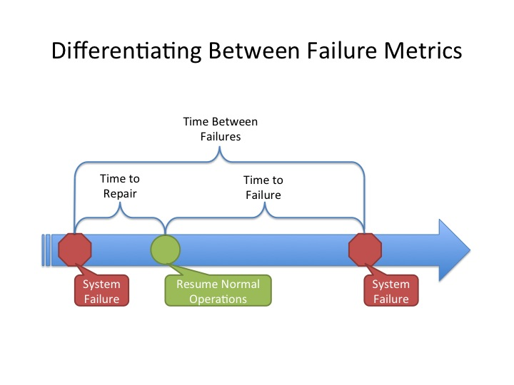
MTBF, MTTR, MTTF
19-<number>

Slide 25
Implementation Metrics
Defects/KLOC
Pages of documentation/KLOC
Number of comment lines/LOC
Cyclomatic complexity (p.481 example 19.5)
  equals to number of binary predicates + 1
  measure the difficulty to comprehend a function/module
  measure the number of test cases needed to cover all independent paths (basis paths)
19-<number>

Slide 26
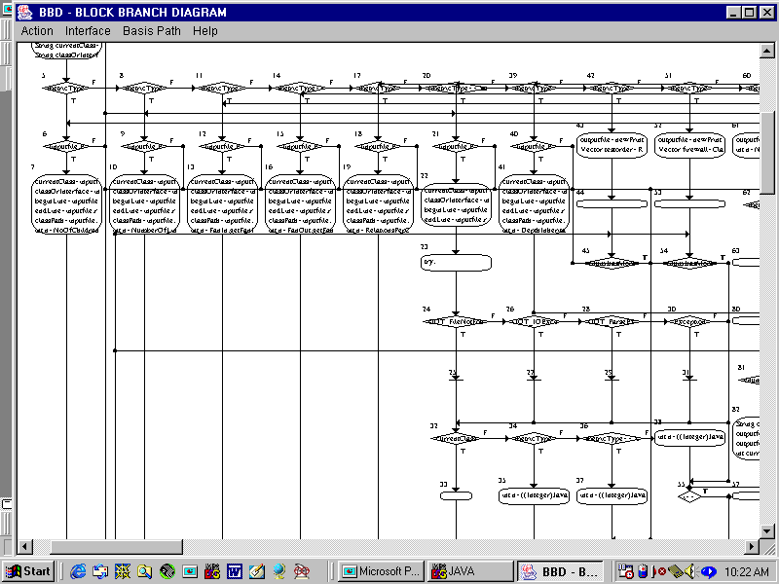
What is the cyclomatic
complexity of this
module?
19-<number>

Slide 27
Object-Oriented Quality Metrics
Weighted Methods per Class (WMC).
Depth of Inheritance Tree (DIT).
Number of Children (NOC).
Coupling Between Object Classes (CBO).
Response for a Class (RFC).
Lack of Cohesion in Methods (LCOM).
19-<number>

Slide 28
Weighted Methods per Class
WMC(C) = Cm1 + Cm2 + ··· + Cmn
Cmi=complexity metrics of methods of C.
Significance: Time and effort required to understand, test, and maintain class C increases exponentially with WMC.
19-<number>

Slide 29
Depth of Inheritance Tree (DIT)
Distance from a derived class to the root class in the inheritance hierarchy
Measures
    the degree of reuse through inheritance
    the difficulty to predict the behavior of a class
    costs associated with regression testing due to change impact of a parent class to descendant classes
19-<number>

Slide 30
High DIT Means Hard to Predict Behavior
All three classes include print()
It is difficult to determine which “print()” is used:
public static void main (...) {
Shape p; ….
p.print(); // which print()?
…
}
Shape
print()
Box
print()
Square
print()
19-<number>

Slide 31
ClassA
m()
ClassB
ClassC
m()
ClassD
Change to parent class requires retesting of subclasses.
ClassE
m()
19-<number>

Slide 32
Number of Children
NOC(C)
= | { C’ : C’ is an immediate child of C }|
The dependencies of child classes on class C increases proportionally with NOC.
Increase in dependencies increases the change impact, and behavior impact of C on its child classes.
These make the program more difficult to understand, test, and maintain.
19-<number>

Slide 33
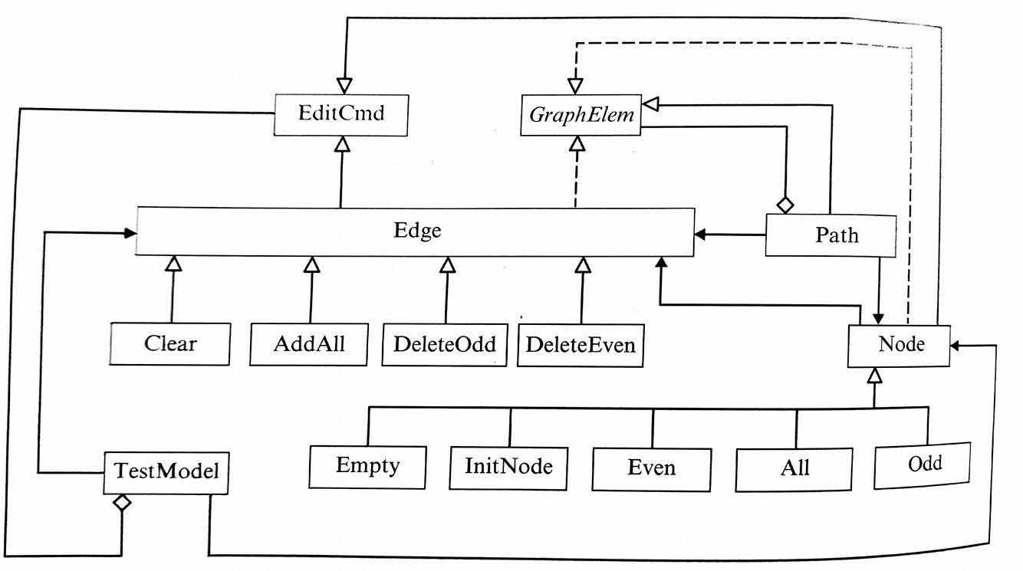
NOC = 0 : Empty, InitNode, Even, TestModel, etc. → Because these are the leaf nodes.
NOC = 2 : EmitCmd
NOC = 3 : GraphElem
NOC = 4 : Edge
NOC = 5 : Node
19-<number>

Slide 34
Coupling between Object Classes
CBO(C) = |{ C’ : C depends on C’ }|
The higher the CBO for class C the more difficult to understand, test, maintain, and reuse class C.
19-<number>

Slide 35
Inheritance
A
CBO (A) = 0
CBO (B) = 1
B
19-<number>
Notes:
這是個 Inheritance 範例 ， B class 繼承 A class ，So CBO(A) = 0 ，CBO(B) = 1
This is an example of Inheritance. Class B extends Class A, So CBO of A is zero and CBO of B is 1.

Slide 36
Association
A
B
CBO (A) = 1
CBO (B) = 0
19-<number>
Notes:
這是個 Association 範例 ， A class association B class ，So CBO(A) = 1 ，CBO(B) = 0
This is an example of association. Class A is in association with Class B, so CBO of A is 1 and CBO of B is 0.

Slide 37
Aggregation
A
B
CBO (A) = 0
CBO (B) = 1
19-<number>
Notes:
這是個 Aggregation 範例 they are Aggregation relationship ，and the dimond is 指向 B，So CBO(A) = 0 ，CBO(B) = 1
This is an example of aggregation. The relationship between A and B is aggregation, and the diamond head points to B, so CBO of A is 0, CBO of B is 1.

Slide 38
CBO = 0 : EditCmd, GraphElem
CBO = 1 :Clear, AddAll, DeleteOdd, DeleteEven, Empty, InitNode, Even, All, Odd
CBO = 2 : Edge
CBO = 3 : TestNodel , Node, Path
19-<number>
Notes:
CBO = 0 : EditCmd and GraphElem because they don’t depend on other classes.
CBO = 1 : The children of Edge and the children of Node .
CBO = 2 : Edge because it depends on EditCmd and GraphElem
CBO = 3 : TestModel, which depends on Node , Edge , and EditCmd.
Node, which depends on EditCmd, Edge and GraphElem.
Path, which depends on Edge, Node and GraphElem

Slide 39
Response for a Class
RFC (C) = |{ m : m is a method of C, or m is called by a method of C }|
The higher the RFC, the more difficult to understand, test, maintain, and reuse the class due to higher dependencies of the class on other classes.
19-<number>

Slide 40
Inheritance
A
M1() M2()
RFC (A) = 2
RFC (B) = 3
B
M3()
19-<number>
Notes:
這是個 Inheritance 範例 ， B class 繼承 A class ，A class 只能使用自己的 M1(), M2() methods ， B class 可以使用父類別的 methods M1() , M2() ，也有自己的methods M3()，So RFC(A) = 2 ，RFC(B) = 3
This is an inheritance example. Class B extends Class A. Class A can only use M1() and M2() methods inside itself, while Class B can use M1(), M2() in Class A, and M3() in Class B, so the RFC of A is 2. The RFC of B is 3.

Slide 41
Association
A
M1() M2()
B
M3()
RFC (A) = 3
RFC (B) = 1
19-<number>
Notes:
這是個 Association 範例 ， ， A class association B class ，A class 可以使用自己的 M1(), M2() methods ，也可以使用 B class M3()， B class 可以使用自己的 M3() methods ，So RFC(A) = 3 ，RFC(B) = 1
This is the example of association. Class A is in association with Class B. Class A can use M1(), M2() and M3(). Class B can use M3() methods only, so the RFC of A is 3 and the RFC of B is 1.

Slide 42
Aggregation
A
M1() M2()
B
M3()
RFC (A) = 2
RFC (B) = 3
19-<number>
Notes:
這是個 Aggregation 範例 ， they are Aggregation relationship ，and the dimond is 指向 B，A class 可以使用自己的 M1(), M2() methods，但不能使用 B class ， B class 可以使用 Class A的 methods M1() , M2() ，也有自己的methods M3() ，Because the dimond ，So RFC(A) = 2 ，RFC(B) = 3
This is the example of aggregation. The relationship between the two classes is aggregation and the diamonds is pointing to B. Class A can use M1(), M2() methods but no M3() methods. Class B can use the two methods in class A and also M3() methods, because of the diamond. Therefore the RFC of A is 2, and the RFC of B is 3.

Slide 43
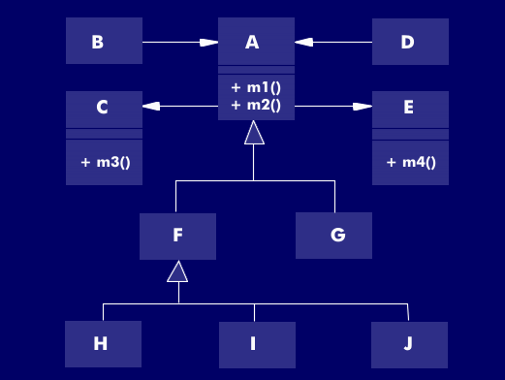
RFC(A) = 4
RFC(B) = 2
RFC(C) = 1
RFC(F) = 0
19-<number>
Notes:
RFC(A) = 4 and RFC(B) = 2
RFC(C) = 1 and RFC(F) = 0.

Slide 44
Lack of Cohesion in Methods
LCOM (C) = n * (n-1) / 2 - 2 *
|{ (mi, mj) : mi and mj share an attribute of C }|
LCOM measures the number of pairs of methods of C that do not share a common attribute.
Class exercise:
  Is it possible to derive a metric called “cohesion of methods of a class?”
  If so, what would be the formula?
19-<number>

Slide 45
A
a,b,c,d,e
M1() M2() M3()
If :
M1 has a,b,c attribute
M2 has c,d attribute
M3 has e attribute
LCOM(A) = 1
19-<number>

Slide 46
Usefulness of Quality Metrics
Definition and use of indicators.
Directing valuable resources to critical areas.
Quantitative comparison of similar projects and systems.
Quantitative assessment of improvement including process improvement.
Quantitative assessment of technology.
19-<number>

Slide 47






Software Verification and Validation Techniques
Inspection
Desk checking
Walkthrough
Peer review
Testing
19-<number>

Slide 48
Software Inspections
Inspector examines the representation with the aim of detecting anomalies and defects.
It does not require execution so it can be used before implementation.
It can be applied to any representation of the system (requirements, design, code, test data, etc.)
It is an effective technique for error detection.
19-<number>

Slide 49
Program Inspection
An approach for detecting defects, not correcting defects.
Defects may be logical errors, anomalies in the code that might indicate an erroneous condition (e.g. an uninitialized variable) or non-compliance with standards.
19-<number>

Slide 50
Program Inspection
Step by step reading the program.
Check against a list of criteria
  common errors
  standards
  consistency rules
19-<number>

Slide 51
Inspection Pre-condition
A precise specification must be available.
Team members must be familiar with the
organisation standards.
Syntactically correct code must be available.
An error checklist should be prepared.
Management must accept that inspection will
increase costs early in the software process.
Management must not use inspection for performance evaluation.
19-<number>

Slide 52
Inspection Procedure
System overview presented to inspection team.
Code and associated documents are distributed to inspection team in advance.
Inspection takes place and discovered errors are noted.
Modifications are made to repair discovered errors.
Re-inspection may or may not be required.
19-<number>

Slide 53
Fagan Inspection Technique
A checklist of inspection items.
It includes design and code inspections.
4 - 5 inspectors: moderator, designer, programmer, tester.
It is good for real-time systems because errors are not repeatable.
Different programmers tend to have different error patterns.
19-<number>

Slide 54
Design Inspection
Precondition: functional requirements and design specification must exist.
Design inspection checks for
  completeness
  consistency, and
  correctness.
19-<number>

Slide 55
Walkthrough
The developer loudly reads through the program.
The developer provides explanation if he/she deems necessary.
Other team members may ask questions and stimulate doubts.
The developer answers questions and justifies answers.
19-<number>

Slide 56
Difference Between Walkthrough and Inspection
Walkthrough
use simple test data
team is led through manual simulation
check product step by step while reading aloud
stimulate doubt and discussions
Inspection
use a list of criteria
  common errors
  standards
  consistency rules
team inspects the product for common errors and compliance to standards and consistency rules
19-<number>

Slide 57
Peer Review
The product is reviewed by peers, guided by a list of review questions.
The review questions are designed to assess the product.
The reviewers are given one to two weeks to review the work.
The review results may vary due to difference in reviewer’s knowledge, experience, background, and criticality.
A review meeting is usually conducted to discuss the review results.
19-<number>

Slide 58
Peer Review Procedure
A product overview is presented to the reviewers, who are assigned products to review.
The reviewers evaluate the product and answer the review questions independently.
At the review meeting, the reviewers present their comments and suggestions, and the developer answers questions and clarifies doubt.
After the review meeting, the developer fixes the problems and produces a summary of solutions. The reviewers check the changes.
A second review meeting may be needed.
19-<number>

Slide 59






Verification and Validation in the Life Cycle
We must ensure that the development activities are carried out correctly.
Software Requirements Analysis
We must check and make sure that the SRS, design, and code are correct.
SRS
Software Design
software design
verification
Coding & Unit Testing
static validation
code modules
We must ensure that the software executes and produces expected results.
Integration & Integration Testing
Acceptance Testing
integrated software
Maintenance
dynamic validation & testing
19-<number>

Slide 60
Verification
Verification is the process of checking that the “implementation” conforms to the “specification.”
A lower level abstraction is the implementation of a higher level abstraction.
Design verification involves checking that the software design satisfies the requirements specification.
19-<number>

Slide 61
Validation
Validation aimed at checking the correspondence between a model and the real world, e.g., a functional specification corresponds to the real needs of the customer.
A process that seeks to refute a model.
Functional testing is a validation technique.
19-<number>

Slide 62
V&V
Verification | Validation
“Are we building the product right?” | “Are we building the right product?”
Process to evaluate the mediator products to check whether the products satisfy the conditions imposed during the beginning of the phase. | Process of evaluating the final product to check if it meets the business needs.
A verifier establishes that the product implements all the requirements documented in the SRS. | The validator establishes that the SRS is a true reflection of the user’s needs.
Notes:
SRS: Software requirements specification

Slide 63
Static and Dynamic Verification & Validation
Review and inspection are concerned with analysis of the static system representation to detect problems (static verification)
Testing is concerned with executing the product and observing its behaviour (dynamic verification)
19-<number>

Slide 64
Formal Verification
A precise mathematical analysis process.
It checks the correspondence between a specification and an implementation.
Example:
  specification: a logical expression of some constraint – bad things should not happen
  implementation: a state machine model representing the design of a system
  formal verification: model checking to find a state that violates the logical expression.
19-<number>

Slide 65
Informal Verification
The correspondence is usually checked by a manual process.
Techniques include desk-checking, inspection, walkthrough, and peer review
19-<number>

Slide 66
Verification Is Consistency Checking
Internal consistency: a specification must not contain a contradiction.
Consistency between two levels of abstraction:
  software design specification and requirements specification
  leveling in Data Flow Diagram decomposition
Consistency between a product and standards.
19-<number>

Slide 67
V&V in the Requirements Phase
Activities performed during the requirements phase include:
  technical review, expert review, and customer review
  prototyping
  inspection, and walkthrough
  formal and informal verifications, and
  requirements tracing
19-<number>

Slide 68
Technical Review
Technical reviews are performed internally by developers looking for:
  incomplete definitions
  incomplete formulation of conditions such as an if-condition without an else part, or less than 2**n rules for n binary conditions
  inconsistencies in requirements, types, and logical expressions
  ambiguities in definitions and requirements
  (to be continued)
19-<number>

Slide 69
Technical Review
  duplicate formulations of concepts, requirements, or constraints
  requirements traceability problems
  unwanted implementation details, e.g.,
    use of pointers, defining physical data structures
    use of pseudo-code or programming language code
  potential feasibility, performance, or cost problems
19-<number>

Slide 70
Checking Requirements and Constraints
Definition completeness
  every concept mentioned in the requirements has an explicit definition
  pay attention to important but undefined adjectives (e.g., good customer receives 20% discount)
  every defined concept has been used at least once
19-<number>

Slide 71
Checking Requirements and Constraints
Type consistency
  types of objects involved in each concept match the definition and each use of the concept
Logical completeness and consistency
19-<number>

Slide 72
Example
Metro Transit provides attractive prices for group travel. 2-9 people traveling together will receive 25% discount; 10 people or more will receive a 40% discount. It also takes into account students and military service. Students are eligible for 50% discount and military service-personal to pay only 25% of the standard rate.
19-<number>

Slide 73
Logical Completeness and Consistency
Rule no.
1
2
3
4
5
Category
Student
Other
Military
Other
Other
Group size
-
1
-
2-9
>=10
Is this decision table complete,
and consistent?
0% dis.
x
25% dis.
x
40% dis.
x
50% dis.
x
75% dis.
x
19-<number>

Slide 74
Ambiguity in Requirements
Example. Metro Transit discount policy:
Children between 2 and 12 pay half price.
Children under 2 years old get 90% discount.
It has 4 possible interpretations
Under 2 (90%)
Between 2 and 12 (50%)
?
[0,2)
(2,12)
What about 2
[0,2)
[2,12]
Ok
[0,2]
(2,12)
Ok
[0,2]
[2,12]
Inconsistency at 2
19-<number>

Slide 75
And/Or Ambiguity
Ex. Passengers over 67 or students under 26 and traveling at least 150 km one way receive a 50% discount.
  A: the passenger is over 67
  B: the passenger is a student under 26
  C: the passenger travels at least 150 km one way
A∨B∧C (literally)
(A∨B)∧C
A∨(B∧C)
19-<number>

Slide 76
What Does Logical Consistency Means?
If Requirements R1, R2, ..., Rk are not logically consistent, then
R1 AND R2 AND ..AND Rk <==> False
R1,...,Rk cannot be true at the same time.
It is impossible to produce a system that can satisfy all the requirements R1,..., Rk.
19-<number>

Slide 77
Completeness, Consistency and Unambigutiy
Completeness: all cases are covered
  external completeness, a validation problem
  internal completeness, a verification problem
Consistency: there exists no contradiction, the system is theoretically possible
Unambiguity: there exists at most one possible interpretation of the requirements
19-<number>

Slide 78
Expert Review
Expert reviews are performed by domain experts, who look for
  inaccuracies in the formulation of domain concepts, regulations, policies, standards
  conceptualization problems
  incorrect formulation of business rules
  other domain specific problems
19-<number>

Slide 79
Customer Review
These reviews are performed with customer representatives and users, and look for
  mismatch between requirements and real world
  problems in user interfaces such as sequence of interaction, look and feel, use of GUI implementation technologies
  issues relating to non-functional requirements
  problems in application specific constraints such as operating environment, costs, political considerations
19-<number>

Slide 80
Requirements Tracing
Performed by the authors of the requirements prior to external reviews.
Ensure that each higher-level requirement corresponds to some lower-level requirements.
Ensure that each lower-level requirement corresponds to some higher-level requirement.
Ensure that lower-level requirements are sufficient to realize the higher-level requirements.
19-<number>

Slide 81
V&V in the Requirements Phase
V&V in the requirements phase also check the requirement-use case traceability matrix
  ensure that each requirement is realized by some use cases, and
  each use case realizes some requirements
Use prototyping to demonstrate capabilities of the system to the customer representatives and user representatives.
19-<number>

Slide 82
V&V of Architectural Design
Activities:
  peer design review
  design inspection
  design walkthrough
Check for design quality metrics.
Check to ensure that requirements and constraints are fulfilled.
Check to ensure software design principles, and security principles are satisfied.
19-<number>

Slide 83
Desirable Properties for Architectural Design
Subsystems and modules should be functionally cohesive.
Interaction between subsystems and modules should be explicit.
Modules should be small and easy to understand.
Decisions should be confined to a single module.
Modules should be easy to test and maintain.
Implicit, global assumptions should be avoided.
19-<number>

Slide 84
V&V in the Implementation Phase
Activities:
  detailed design review
  code review, inspection, and walkthrough
  testing, and
  reliability assessment
Check
  correspondence between the implementation and design
  consistency of module interfaces
  (to be continued)
19-<number>

Slide 85
V&V in the Implementation Phase
  correctness of the implementation
  conformance of coding standards
  proper use of programming constructs
  un-initialized/improperly initialized variables, structures or pointer
  quality of the code according to various code quality metrics
    cyclomatic complexity (must not exceed 10)
    information hiding
    cohesion and coupling
    modularity
    etc.
19-<number>

Slide 86
Software Quality Assurance Functions
Definition of Processes and Standards
  Definition of Process and Methodology
  Definition of SQA Standards and Procedures
  Definition of Metrics and Indicators
Quality Management
  Quality Planning
  SQA Control
Process Improvement
19-<number>

Slide 87


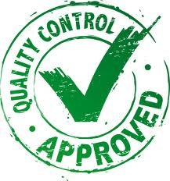
Definition of Processes and Standards
Definition of a SQA framework
  defining development, quality assurance, and management processes and methodologies (see Figure 19.5 for SQA in plan-driven and agile processes)
  defining SQA standards, procedures, and guidelines
  defining quality metrics and indicators for quality measurement and assessment
19-<number>

Slide 88


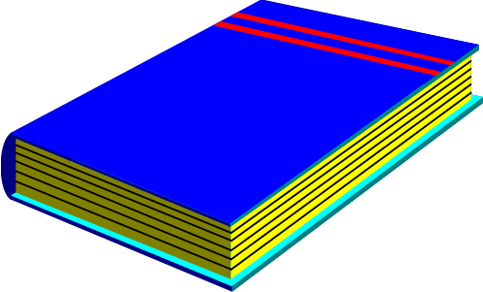
Quality Management Planning
Quality planning defines a scheduled sequence of activities to be carried out to assure the desired software quality
Examples are ANSI/IEEE Standard 730-1984, and 983-1986 SQA Plans
19-<number>

Slide 89
Components of an SQA Plan
Purpose - objectives and scope of the plan as well as the product and its use.
Management – project organization, and team structure including roles and responsibilities for SQA functions and activities.
Standards and conventions to be applied.
Review and audit – types of reviews to be used, problem reporting, and correction procedures.
(to be continued)
19-<number>

Slide 90
Components of an SQA Plan
Software configuration management – activities to ensure consistent update, and track changes.
Processes, methodologies, tools, and techniques to be used.
Metrics and indicators to be applied.
19-<number>

Slide 91
Humphrey’s Quality Plan Outline
Product introduction
  A description of the product, its intended market, and the quality expectations for the product.
Product plans
  The critical release dates and responsibilities for the product along with plans for distribution and product servicing.
Process descriptions
  The development and service processes which should be used for product development and management.
Quality goals
  The quality goals and plans for the product, including an identification and justification of critical product quality attributes.
Risks and risk management
  The key risks which might affect product quality and the actions to address these risks.
19-<number>

Slide 92

SQA Control
It ensures that the SQA plan is carried out correctly.
It monitors the software development project.
It collects and manages SQA related data.
It reports the data to software process improvement process.
19-<number>

Slide 93
Process Improvement
Definition and execution of a process improvement process (PIP).
It defines metrics and indicators for process improvement.
It gathers data for improving the process.
It computes the metrics and indicators.
It produces process improvement recommendation to the management.
19-<number>

Slide 94
Applying Agile Principles
Good enough is enough.
Keep it simple and easy to comply.
Management support is essential.
A collaborative and cooperative approach between all stakeholders is essential.
The team must be empowered to make decisions.
Values working software over comprehensive documentation.
19-<number>

